Slide 1
Title of Project: Gender Classification Using Facial Images

Slide 2
Name of Students: Mr. Padmanabhan Deokar (2020BTEIT00024) Mr. Harshad Jagadale(2020BTEIT00025) Mr. Vaibhav Done(2020BTEIT00028) Under the Guidance of Dr. S. P. Sonavane

Slide 3

Agenda:
Problem statement
Significance
Objectives
Methodology
Tools and Technologies
References

Slide 4

Problem statement:
To implement Local Binary Pattern(LBP) for facial feature extraction.
To implement Support Vector Machine(SVM) for classification into male and female.

Slide 5
Significance:
The proposed system of gender detection is to classify human facial image into male and female comparing features of facial images of the datasets.
LBP and SVM together gives accuracy around 94.7% .
Time complexity for Local Binary pattern is O(1).
Time complexity for Support vector machine is O(N^2*k).

Slide 6

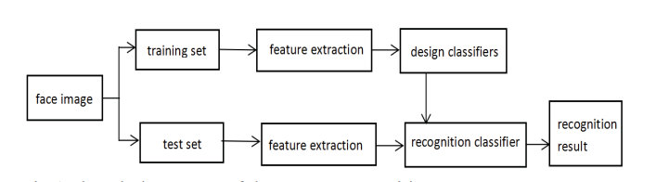
Flow of Program:

Slide 7
Objectives:
To compare input image features with features of images of the Kaggle dataset.
To construct two dimensional array containing of pixel values of input image.
To classify gender based on feature like eye,
eye- brow,facial hair,nose.

Slide 8

Methodology:
Gender Classification is decomposed into two parts
1.Feature Extraction
2. Classification
Feature Extraction involves following steps:
1.Convert input image into grayscale
2.Set pixel value as center pixel
3.Collect neighbourhood pixel(3x3 matrix)
4.Neighbourhood pixel value is 1 if it’s value
greater than center pixel otherwise 0
5.Replace center pixel value with resulted decimal
value

Slide 9
Methodology:
Classification involves following steps:
1.Import dataset
2.Explore the data to figure out
3.Divide the data into training and testing
4.Train the SVM algorithm
5.Evaluate the result of the algorithm

Slide 10
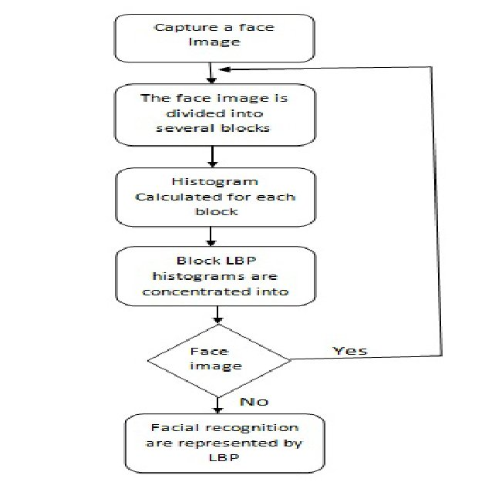
LBP flowchart:

Slide 11



Tools and Technologies:

Slide 12
Reference:
Ahmed, T.U., Hossain, M.S., Alam, M.J., Andersson, K.: An integrated CNNRNN framework to assess road crack. In: 2019 22nd International Conference on Computer and Information Technology (ICCIT), pp. 1–6. IEEE (2019)
Liu Tianyu, Li Fei, Wang Rui: Human Face Gender Identification Systems on MB-LBP Engineering Training Center, Shenyang,110136, China.2018 IEEE.
Tahmina Akter Sumi , Mohammad Shahadat Hossain , Raihan Ul Islam and Karl Andersson:Human Gender Detection from Facial Images Using Convolution Neural Network, Department of Computer Science and Engineering, University of Chittagong, Chittagong, Bangladesh Eds.: AII 2021, CCIS 1435

